Slide 1
CSE1006 – Blockchain and Cryptocurrency Technologies MODULE - 7
Altcoins and the Cryptocurrency Ecosystem
Dr. Jayanthi.R

Slide 2
Content
Altcoins: History and Motivation
A Few Altcoins in Detail
Relationship Between Bitcoin & Altcoins
Merge Mining
Atomic Cross chain Swaps
BitcoinBacked Altcoins, Side Chains
Ethereum and Smart Contracts

Slide 3
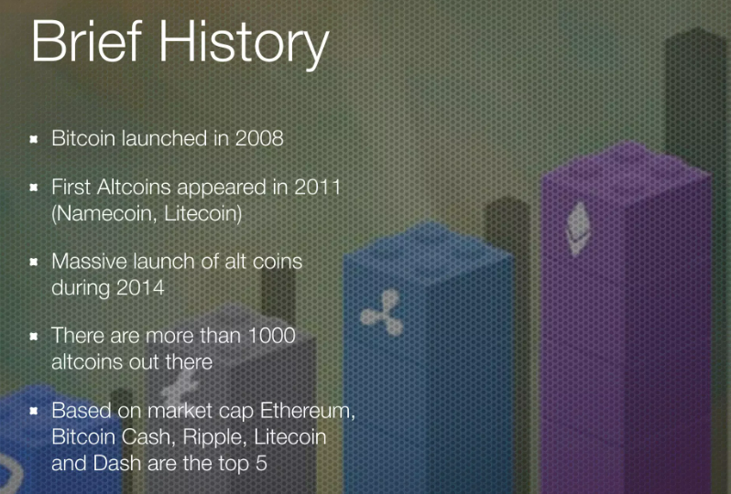
Altcoins: History and Motivation

Slide 4
Altcoins: History and Motivation
Altcoins are viewed as any type of crypto other than Bitcoin.
Many altcoins were launched after a fork from Bitcoin (or another blockchain like Ethereum).
Altcoins are designed to address specific issues like transaction speeds or security factors or to facilitate other functions on a blockchain.
The first altcoin was Litecoin, which was a fork of the Bitcoin blockchain that launched in 2011. Because there weren’t many Bitcoin competitors at that time, the term “altcoin” came into being to describe the new arrivals.
In addition to Ethereum, which is the second-largest crypto after BTC.

Slide 5
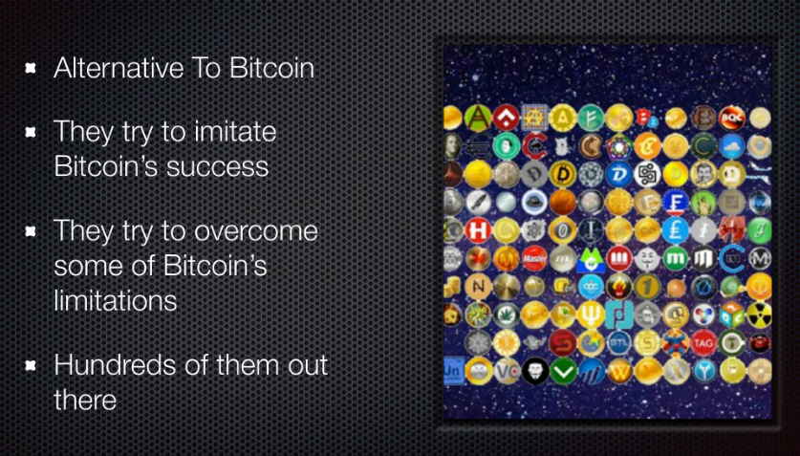
Understanding Altcoins

Slide 6
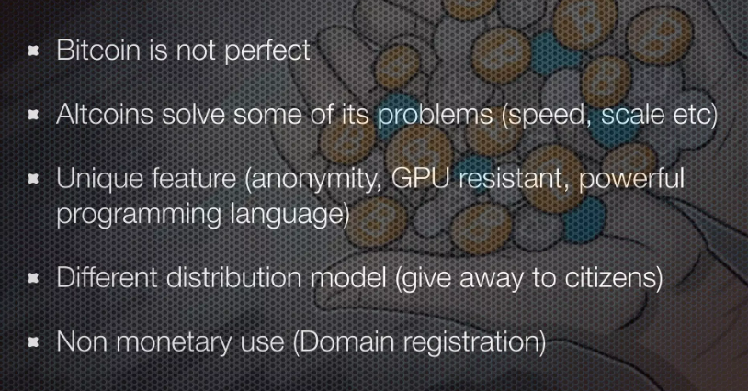
Why They Exist

Slide 7
Altcoin classification
Altcoins classification can rely on AltCoins genealogy.
For example,
There are many Bitcoin-like alternatives that started from Bitcoin basics with some changes through a fork.
If we look at Altcoins, we can see that many of them come from a fork of famous and long-lasting cryptocurrencies such as Bitcoin, Litecoin, and Ethereum.
Every Altcoin has something that distinguishes it from others, such as
differences in the scripting language, transactions management, additional features or security, mining-based or not, with different consensus algorithms, and so on.
They can also differ from Bitcoin simply because they have different built-in parameters, such as average time between block creation or block size.

Slide 8
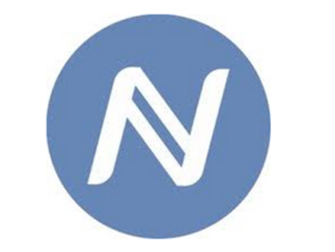
A Few Altcoins in Detail
Namecoin: decentralized domain name management
Namecoin was the first Altcoin born in 2011, around two years after Bitcoin.
Its purpose was to replace the domain name system in a decentralized way.
A specific plugin for Firefox or Chrome is available in order to access to any website ending with ".bit".
It will automatically take you to the right location indicated by the registry stored on Namecoin.
To register a domain in Namecoin and keep it, it is necessary to send a transaction to the Namecoin system.

Slide 9
A Few Altcoins in Detail
Namecoin has many interesting properties:
It gives the possibility to register a domain name that is not already in use for a small fee, corresponding to 0.01 Namecoin (around 0.05$). So, the cost is far less than the cost of registering a domain name following the standard procedure.
It is not necessary to pay a renewal fee to keep the domain.
Namecoin manages subdomains in the same way as the current domain system. For example, if you register mywebsite.bit, you have access to all its subdomains.
It is also possible to transfer domains to other people selling them in exchange for some Namecoins.
It was the first Altcoin to feature merge mining

Slide 10
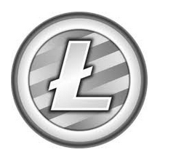
Litecoin: first memory-hard mining puzzle
Litecoin was born in 2011 after Namecoin.
For several years Litecoin was the second main cryptocurrency after Bitcoin.
The main technical difference from Bitcoin is its mining puzzle.
Litecoin uses a memory-hard mining puzzle, while Bitcoin is a computation-hard one.

Slide 11
Litecoin: first memory-hard mining puzzle
In 2011, Bitcoin mining already required GPUs and Litecoin’s purpose was to be GPU resistant.
It was possible to improve Litecoin mining first using GPUs and then with a specific Litecoin ASIC.
Litecoin is the second most forked cryptocurrency and, besides the mining puzzle, it differs from Bitcoin just for some parameters change.
For example, the time between block creation is 4 times smaller than Bitcoin (2.5 minutes instead of 10).

Slide 12

PeerCoin: first proof-of-stake mining puzzle
PeerCoin was born towards the end of 2012 and uses a very different mining puzzle: proof-of-stake.
This method doesn't involve any computational work. Instead, it involves mining by making transactions using coins owned by the miner.
Coins acquire more stake over time as long as the miner doesn't spend them.
Peercoin mining is a little more complicated, since it is an hybrid mining protocol and supports also proof-of-work, but only for minting.

Slide 13
PeerCoin: first proof-of-stake mining puzzle
The proof-of-work blocks aren’t included in the calculation to determine what the longest Peercoin blockchain and their only purpose is to create new coins.
An attacker with a high computation power doesn't have advantages in launching attacks against the Peercoin network.
In addition, there's the concept of Peercoin administrators who own a trusted public key used to sign checkpoints in a certain number of blocks.
This acts as a safeguard against attacks but leads to the fact that Peercoin isn't fully decentralized.
In addition, we can't prove that proof-of-stake is a very secure mining protocol since Peercoinrelies on these checkpoints.

Slide 14
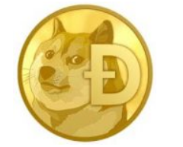
DogeCoin: having fun with cryptocurrency
DogeCoin was born at the end of 2013.
A few technical changes from Bitcoin, the main difference between Dogecoin and other currencies is that it was born with the purpose of having fun with cryptocurrency.
Dogecoin supported many marketing campaigns and public events, which let it become popular in a very short term after its launch.
For example:
It sponsored a NASCAR driver which ran with the Dogecoin logo on his car
The community raised over 30 thousand dollars to support the Jamaican bobsled team to let them travel and compete in the 2014 Winter Olympic Games.

Slide 15
DogeCoin: having fun with cryptocurrency
One interesting technical difference from other cryptocurrencies was the notion of random block rewards.
Rather than having a fixed block reward, each block bonus is random.
It depends on a pseudo-random function applied to the previous block hash.
So, miners knew the reward before the block insertion.
if the reward was really low, they could switch to other cryptocurrencies mining.
This feature was removed a few months after the launch.
Now Dogecoin block reward is fixed and halved every two months

Slide 16
Interactions between Bitcoin and Altcoins
There are many interactions between Bitcoin and Altcoins.
They all compete with each other.
For example
As a large Bitcoin mining pool with a lot of computation power.
If there’s another small cryptocurrency with the same mining algorithm.
This mining pool could be more powerful than 50% of this small cryptocurrency network and decide to influence it.

Slide 17
Interactions between Bitcoin and Altcoins
Comparing altcoins: market capitalization
​Traditionally, market capitalization or market cap is a simple method of estimating the value of a public corporation by “multiplying the price of a share by the total number of shares outstanding”.
In the context of altcoins, this market cap is often similarly used “to estimate the total value of the altcoin by multiplying the price of an individual unit of the altcoin by the total number of units of currency of the altcoin” thought to be in circulation.
By this metric, in 2015 over 90% of the overall market cap of all of the cryptocurrencies combined.
The relative ranking of the other altcoins tends to vary a lot, but the point is that most altcoins are comparatively tiny in terms of monetary value.

Slide 18
Interactions between Bitcoin and Altcoins
Comparing altcoins: market capitalization – cont..
It’s important not to read too much into the market cap.
First, it isn’t necessarily how much it would cost for someone to buy up all the coins in circulation.
That number might be higher or lower because large orders will move the price of the currency.
Second, even though the calculation considers only the coins currently in circulation, we should expect that market participants factor into the exchange rate the fact that new coins will come into circulation in the future, which further complicates the interpretation of the number.
Finally, we cannot even accurately estimate the true number of coins currently in circulation because the owners of some coins may have lost their private keys, and we’d have no way to know.

Slide 19
Interactions between Bitcoin and Altcoins
2. Comparing altcoins: mining power
​If two altcoins use the same mining puzzle, we can directly compare them by how much mining power all of the altcoin’s miners have. This is often called the hash rate due to the prominence of hash‐based puzzles.
For example, Zetacoin is an altcoin that uses SHA‐256 mining puzzles, just as Bitcoin does, and has a network hash rate of about 5Terahashes/second(5*10​ ¹²​hashes/second) as of December 2015.
This number is about a hundred‐thousandth of Bitcoin’s mining power.
It’s trickier to compare the mining power between coins that use different mining puzzles because the puzzles may take different amounts of time to compute.
Besides, mining hardware specialized for one of the coins won’t necessarily usable for mining (including attacking) the other coin.

Slide 20
Interactions between Bitcoin and Altcoins
Even for an altcoin using a completely unique mining puzzle, we can still learn something from the change in mining power over time.
Growth in mining power indicates either that more participants have joined or that they have upgraded to more powerful mining equipment.
Loss of mining power usually means some miners have abandoned the altcoin and is a threatening sign.

Slide 21
Interactions between Bitcoin and Altcoins
3.Comparing altcoins: other indicators. ​
There are several other indicators we can look are,
Changes in an altcoin’s exchange rate over time to correlate with changes in its hash rate over long time periods.
Exchange volume on various third‐party exchanges is a measure of activity and interest in the altcoin.
the volume of transactions that have been made on the altcoin’s blockchain doesn’t tell us much, it could be users shuffling their own coins around in their wallets.

Slide 22
Finally, we can also look at how many merchants and payment processors support the altcoin —is only the most prominent ones tend to be supported by payment processors.
4. The economic view of Bitcoin‐altcoin interactions.​
The relationship between Bitcoin and altcoins is complicated.
In one sense, cryptocurrencies compete with each other, because they all offer a way to do online payments.
If there are two standards, protocols, or formats in a competition that are roughly equivalent in terms of what they offer, then one of them will usually come to dominate, because of what economists call “network effects

Slide 23
Mining power based attacks
Attacks based on mining power have already happened.
There’s a famous story regarding an old coin called CoiledCoin.
It was a small currency born in 2012.
A large Bitcoin mining pool, Eligius decided that CoiledCoin was a scam and launched an attack on its network.
This attack involved mining a lot of blocks in order to make an entire day of CoiledCoin transactions invalid.
After this attack, all the users moved away from the network and this coin doesn’t exist anymore.
Similar attacks happened against other Altcoins, such as TerraCoin and WorldCoin.
In these cases, the attacks lasted less time and the Altcoins survived.

Slide 24
Merge Mining – Definition
Merged mining or combined mining is a protocol that allows two different blockchains that share the same consensus protocol and hash function, to be mined together without loss of performance and maintaining a high level of security
OR
Merged mining refers to a process that enables an individual to mine more than one cryptocurrency simultaneously without compromising on computational performance. This is possible through a consensus mechanism known as Auxiliary Proof of Work (AuxPoW).
The idea behind AuxPoW is that the work done on one blockchain can be leveraged as valid work on another chain.
Around 2014, a new mining model in which the same miner could dedicate himself to mining blocks in two or more different blockchains, a concept known today as Merged Mining or combined mining.

Slide 25
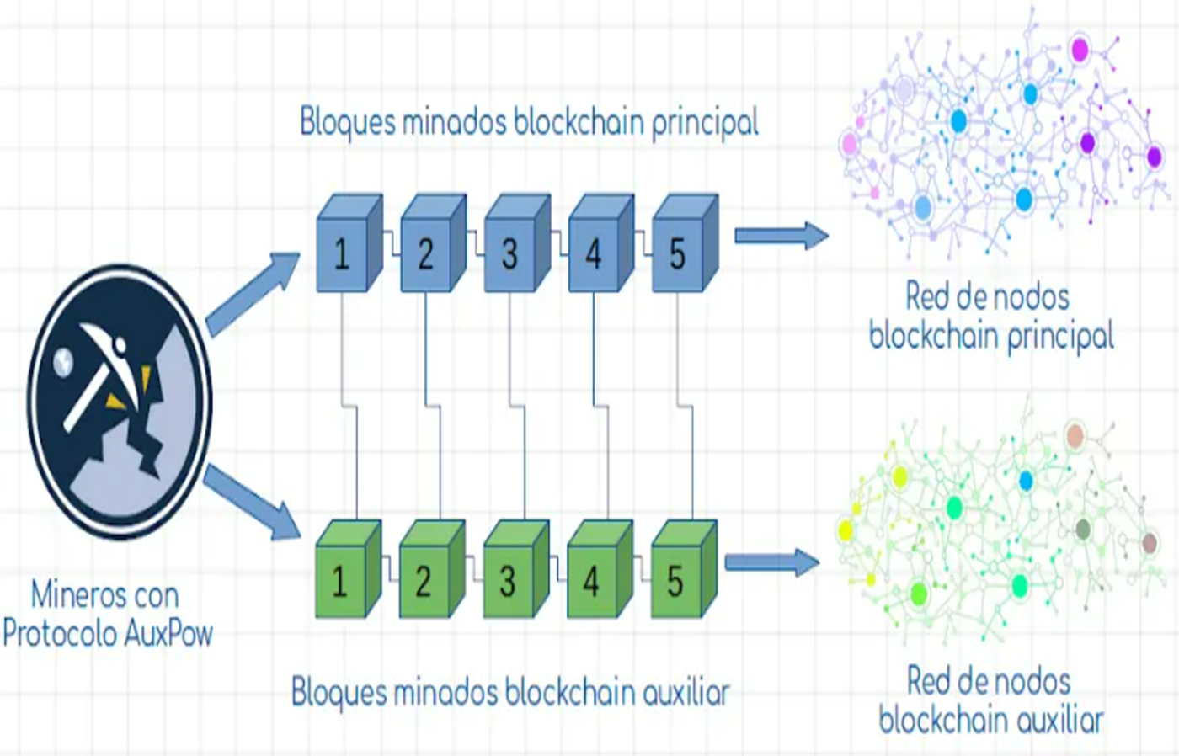
Merge Mining
The blockchain that provides the proof of work is called the parent blockchain, while the one that accepts it as valid is the auxiliary blockchain.
To perform merged mining, all the involved cryptocurrencies must be using the same algorithm.
For instance, Bitcoin uses SHA-256, meaning that virtually any other coin that uses SHA-256 can be mined along with Bitcoin - as long as the technical implementations are properly done.

Slide 26
Can we ensure that blocks of a merge‐mined altcoin are created at a steady rate, as high or low as we want, irrespective of the fraction of Bitcoin miners mining it? The answer is yes.
The trick is that even though the mining task for the altcoin is the same as that of Bitcoin, the mining ​ target ​need not be the same.
The altcoin network computes the target and difficulty for its blocks independently of the Bitcoin network.
Just as Bitcoin adjusts its mining target so that blocks are found every 10 minutes on average, the altcoin would also adjust its own target so that blocks in the altcoin are found every 10 minutes or any other fixed value.

Slide 27
This means that the altcoin’s target will be much less than Bitcoin’s target, and some altcoin blocks will not be pointed to valid Bitcoin blocks.
You should think of the Bitcoin blockchain and the altcoin blockchain as two parallel chains, with pointers from a Bitcoin block to an altcoin block.
This is illustrated below Mining Architecture.
In this example, 60% of Bitcoin miners mine the altcoin, and the altcoin’s time between blocks is 5 minutes.
This means the altcoin’s difficulty is 60% * 5 / 10 = 30% that of Bitcoin.
Note that 40% of Bitcoin blocks do not contain hash pointers to altcoin blocks

Slide 28
Every valid altcoin block results from an attempt at mining a Bitcoin block, but only 30% of them actually meet Bitcoin’s difficulty target.
For the other 70% of altcoin blocks, the altcoin network needs to be able to verify the mining puzzle solution.
The simple way to do this is to broadcast the Bitcoin near‐block in addition to the altcoin block.
But a cleverer way is to broadcast just the header of the Bitcoin near‐block and the Merkle proof of inclusion of the Coinbase transaction in the Bitcoin block.

Slide 29
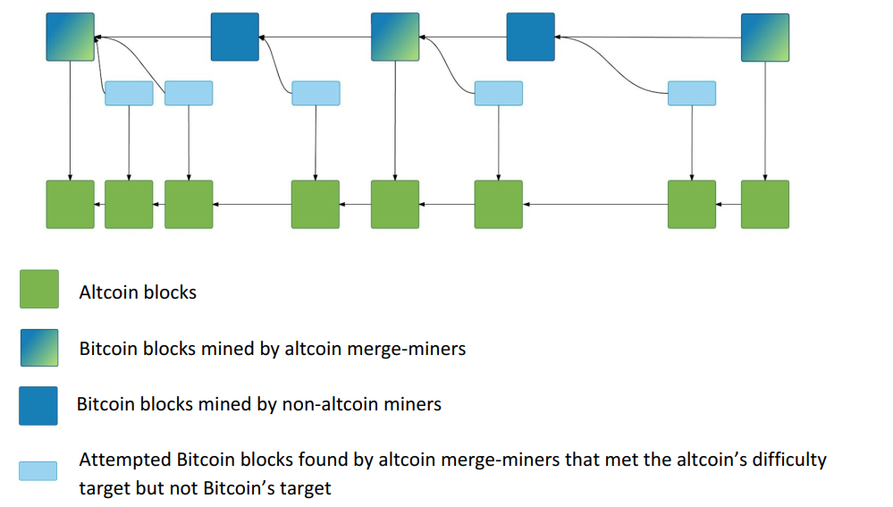
Merge Mining Architecture

Slide 30
Merge Mining Features
Merge Mining feature allows to combining mining of different altcoins.
In ordinary mining you can try to find a solution for a mining puzzle for a single cryptocurrency.
So, your hash power can be divided among different currencies, but not used at the same time to mine both.
For example, a Bitcoin mining puzzle requires computing the hash over a string that depends on the last block.
Even if the Altcoin was a Bitcoin fork and shared Bitcoin mining puzzle, the puzzle solution would be based on its last block and not Bitcoin’s.

Slide 31
Merge Mining
Blockchains of any cryptocurrencies are completely independent and do not cross each other.
There is a possibility that miners will use their mining power (hash rate) to create a valid hash for both networks.
An example that we saw come true with the birth of Namecoin, a project that benefited from the mining power of Bitcoin for its functionality.
The concept of merged mining may give rise to the belief that the miner requires greater computing power to mine blocks in two or more different blockchains. This mining model does not affect the performance of the mining equipment in any way.
“A miner can use his computing power to generate different hashes and check them on several different blockchains.”

Slide 32
Merge Mining
By this way, if one of the following hashes is valid for Bitcoin,
For example,
The miner will receive the reward for his work in bitcoins (BTC).
Whereas if the hash is valid for the Namecoin network, the miner will then receive his namecoins reward (NMC).
Basically it is a job that pays two for one, and it is a situation that benefits you because it generates much more profit.

Slide 33
How can this be possible if both networks have different transactions?
How can you not hurt the performance of the miner if you mine on two chains?
What was the origin of Merged mining? How does it work in detail?
What projects take advantage of it?
Origin of Merged Mining or Combined Mining
The concept of merged mining came to life at the beginning of 2014 when the Auxiliary Proof of Work. This is the protocol that allows the work done within a blockchain network of the type PoW, can be used as your own proof of work in another blockchain network for block mining.
The implementation of AuxPoW started in the blockchains of Bitcoin and Namecoin.
This was possible thanks to the fact that both blockchains operate under the mining algorithm, the SHA-256.

Slide 34
This is one of the main needs of this protocol, blockchain must share the same protocol, or it is impractical.
The development of AuxPoW then continued with its development in Dogecoin and Litecoin.
In this case, both networks work under the algorithm scriptSig for block mining.
How does Merged Mining or Combined Mining work?
The developers managed to create this mining protocol and thus take full advantage of the mining power of the equipment.
By Multiple chains simultaneously and synchronously.

Slide 35
Suppose the miner puts here the data corresponding to the altcoin’s previous block and transaction Merkle root tree.
Now he’s computing a hash over a string that contains both the Bitcoin previous block information and the Altcoin ones.
So, every time he computes a hash it could be a solution both for Bitcoin and Altcoin.
This is a way to mine one or more Altcoins onto Bitcoin.
This encourages miners to work also on Altcoins with lower value and rewards. But it could also make attacks easier since miners could use all their mining power for an Altcoin without the need to stop mining Bitcoin.

Slide 36
Many large mining pools in Bitcoin actually provide services to help its members merge many compatible coins at once.
The most popular Bitcoin mine merged cryptocurrencies are Namecoin, IXCoin and Devcoin.
So these become the most popular Bitcoin-compatible merge mined altcoins.

Slide 37
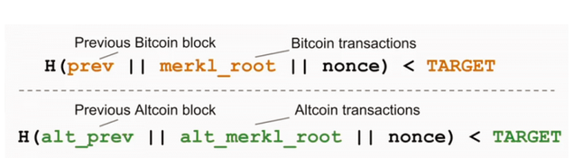
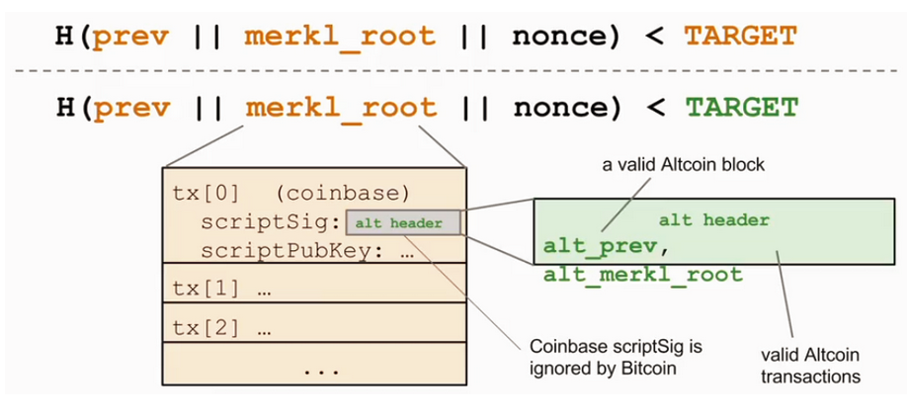
Merge_mining_puzzle_solutions

Slide 38
Merge Mining
Finally, note that any number of altcoins can be simultaneously merge‐mined with Bitcoin, and every miner is free to pick an arbitrary subset of altcoins to merge mine.
In this case, the Coinbase scriptSig would itself be a Merkle tree of hash pointers to various altcoin blocks.
Note the levels of complexity:
The inclusion of an altcoin transaction requires verifying, among other things:
(1) a Merkle proof of inclusion of the altcoin transaction in the altcoin block
(2) a Merkle proof of inclusion of the altcoin block hash in the Coinbase scriptSig and
(3) a Merkle proof of inclusion of the Coinbase scriptSig in the Bitcoin block or near‐block

Slide 39
Altcoin creation and launch
We are going to see,
How the lifecycle of an Altcoin works.
What's necessary to launch and maintain it?
what are the key points which let an Altcoin be profitable or not?
An Altcoin generally involves creating a new reference client, by forking an existing cryptocurrency code.
This can happen to change some parameters to the original software.
Then making the software available to the community for download.
To properly launch a cryptocurrency it is necessary to stimulate interest in the community. In particular,
Miners:
some people must be interested in maintaining the network in exchange for some profit. The higher the miners’ number, the more secure the network will be.

Slide 40
Stakeholders:
some people must be interested in buying cryptocurrency and holding it.
Developers: it is important to have a good development team. In fact, it will be necessary to make some improvements in the network, correct any problem and make the system more scalable as soon as the number of transactions and members will start to grow.
liquidity:
To encourage cryptocurrency buying and selling, It would be easier if there are some websites or places where it can be exchanged with FIAT currency or other cryptocurrencies.
Note:
The main difference between fiat currency and cryptocurrency is that cryptocurrencies don't require government backing, while fiat currencies depend on it
There are some services on the web that let create a new client and cryptocurrency automatically. They exchange for a fee or even free.
For example Build a Coin, Altcoin Generator or CryptoLife.
That's why we referred to the technical part as the easy part.

Slide 41
Features that help an Altcoin to be successful
To launch a new cryptocurrency there are some features that help to be successful,
For example:
1. Tipbots, faucets:
These help people who don't necessarily belong to the network gain coins. For example, they could enter their mail address as a reference and gain a small portion of the coin, claiming a faucet from time to time.
2. Logo, brand, marketing:
They have some kind of distinctive marketing or branding that makes the Altcoin memorable. For example a logo or a slogan that shows its peculiarities.
3. Exchanges, payment processors:
It is important that Altcoin enters into exchanges or payment processor services. So that it is possible to buy or sell the currency in exchange for other FIAT and cryptocurrencies or buy goods.

Slide 42
Features that help an Altcoin to be successful
4. Developer tools, block explorers, and testnet:
To raise the interest of developers it is important to provide APIs and developer tools. These help them build applications on top of the network infrastructure.
It is also important to provide block explorers and a testnet where to make experiments.
5. Steering foundation:
Most Altcoins have a steering foundation that gives guidelines, encourages development, and maintains the Altcoin.

Slide 43
Cryptocurrencies pump-and-dump scheme
“pump-and-dump” schemes (P&Ds) using the cryptocurrency market as our empirical setting. P&D is a form of price manipulation that involves artificially inflating an asset’s price before selling the cheaply purchased asset at a higher price.
Once the assets are “dumped,” the price falls and investors lose money. Such schemes are most common with microcap stocks and have recently become popular in the cryptocurrency market (Shifflet and Vigna, 2018).
P&Ds illegal in the stock market, but regulation of P&Ds in the cryptocurrency market is weak or nonexistent.
Many cryptocurrencies are difficult to justify as investment or consumer products and do not fit neatly into existing securities or consumer protection laws.
The regulation of cryptocurrencies also requires a greater degree of global coordination than other assets because they typically are traded globally

Slide 44
Cryptocurrencies pump-and-dump scheme
On the other hand, many Altcoin are supposed to follow a pump-and-dump scheme. (P&D scheme).
To conduct a pump-and-dump attack, pick a target Altcoin that's about to launch or an existing one without many participants and acquire a huge portion of this Altcoin.
Then make some marketing campaign that tries to spread the idea that this huge money distribution was due to raising interest in the currency.
After many people follow the trend and start buying this coin, sell the whole amount previously acquired to gain money.

Slide 45
Cryptocurrencies pump-and-dump scheme
If the ownership portion was large, the money price would drop again.
This kind of scheme can also be applied by founders who reserve themselves an initial coin portion.

